Slide 1
Measuring Earthquakes

Slide 2
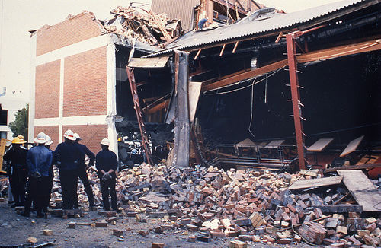
By the end you should be able to:
1. | Describe and identify hazards that are created by volcanoes;
2. | Compare the effects of two historic volcanic eruptions.

Slide 3
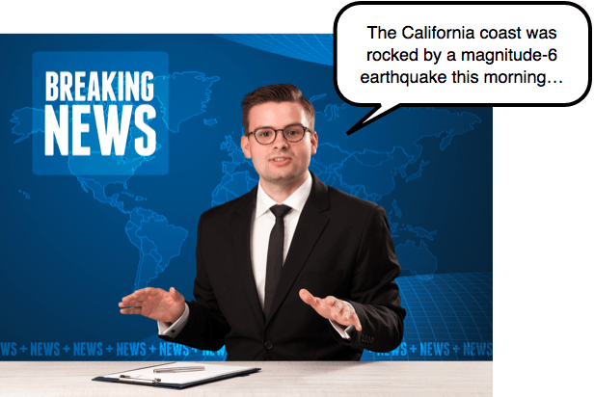
When a major earthquake strikes, even if you don't feel it here in Australia, it's all over the news for days afterward.
News reporters like to throw lots of numbers at you to show how big the quake was. What do those numbers mean?
We're going to look at how the size of an earthquake is measured. Magnitude and intensity are the key terms you should understand by the end.

Slide 4
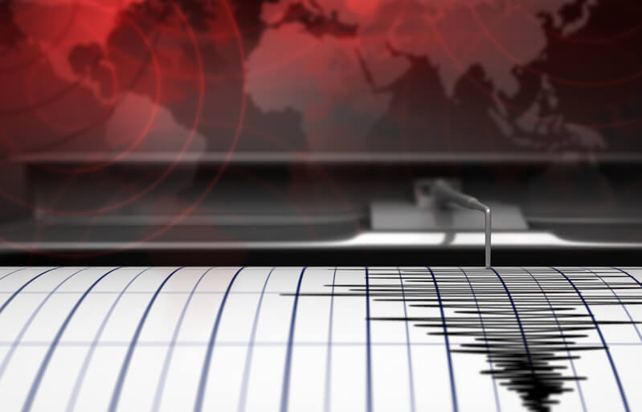
First of all, let's look at the term 'magnitude'.
An earthquake is a release of energy from a fault line under the Earth's surface. The magnitude of an earthquake tells us how much energy is released.
Some of the energy stored in a fault line is converted into seismic waves, which travel through the Earth and cause the ground above to shake. The more energy is sent out, the higher the earthquake's magnitude and the greater the damage it can cause.

Slide 5
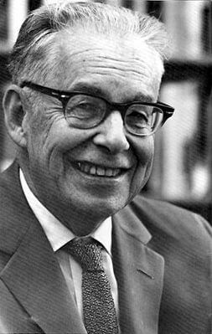
The Richter Scale
In the 1930s, physicist Charles Richter developed the famous Richter magnitude scale. It was used by scientists up until the 1970s, when a revised scale came along.
The Richter scale is logarithmic. This means an increase of 1 level on the scale represents about 31 times the amount of energy released.
The more seismic energy, the more shaking occurs!

Slide 6
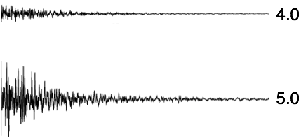
The Richter Scale
For example, a 5.0 magnitude quake releases 31 times more energy than a 4.0 magnitude one.
It also produces a much stronger signal on a seismogram, as you can see here:

Slide 7
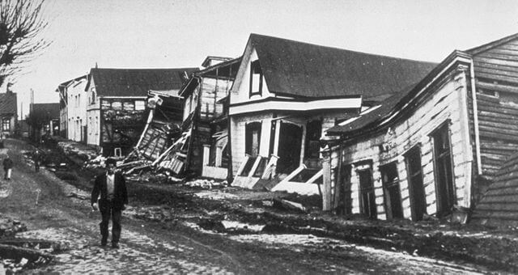
In 1960, a truly terrifying earthquake hit the Chilean city of Valdivia.
It had the largest magnitude ever recorded; an astounding 9.5 on the Richter scale!
During this event, the ground shook for 10 whole minutes. It caused widespread damage to buildings, massive landslides and powerful tsunami waves. 1655 people lost their lives and 3000 were injured. Around 2 million people had to leave the Valdivia area.

Slide 8
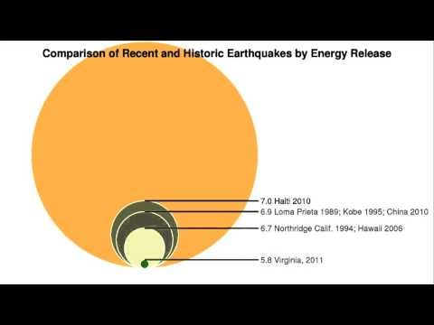

Slide 9
Another key feature of an earthquake is its intensity.
Intensity takes into account the effects of an earthquake, such as severity of shaking and levels of damage. It varies across land, but is usually highest near the epicentre of the earthquake.
Intensity depends on multiple factors that include (in no particular order):
1. | Magnitude
2. | Depth
3. | Geology
4. | Population density

Slide 10

Magnitude
As you have just learnt, the magnitude of an earthquake indicates how much energy it releases into the Earth. The more energy, the more damage can occur.
Therefore, the intensity of an earthquake depends on its magnitude, but this isn't the only factor!

Slide 11
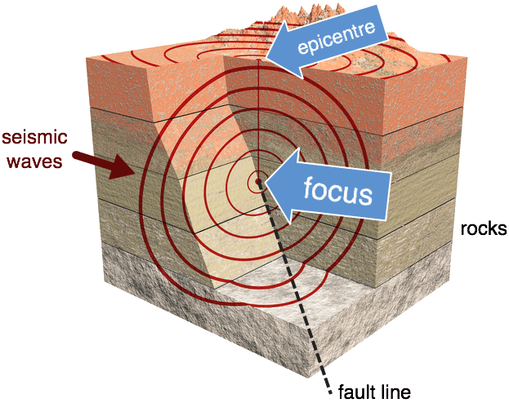
Depth
If the focus of an earthquake is very far below the surface, most of its energy will be absorbed by the Earth. Very deep earthquakes are rarely felt by people.
However, if the focus is very shallow, then the intensity will be higher because more of that energy can reach the surface.

Slide 12
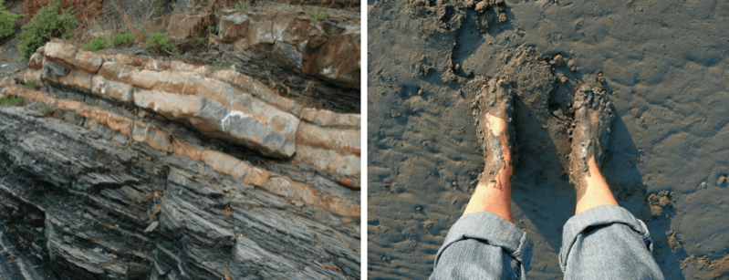
Geology
This refers to the shape of the land and the natural materials that support it. These factors also affect earthquake intensity in a particular area.
For example, areas underlain by fine-grained sedimentary rocks withstand earthquakes well, because these rocks reduce the shaking. By contrast, areas dominated by wet soil and mud sometimes amplify the shaking, making it even worse!

Slide 13

Population density
Where people are relative to the epicentre is probably the most important factor in determining an earthquake's maximum intensity.
If an earthquake happens in a remote, uninhabited area, it will do little or no damage to people or cities. However, if it happens in the middle of a major city, the damage could be catastrophic!

Slide 14
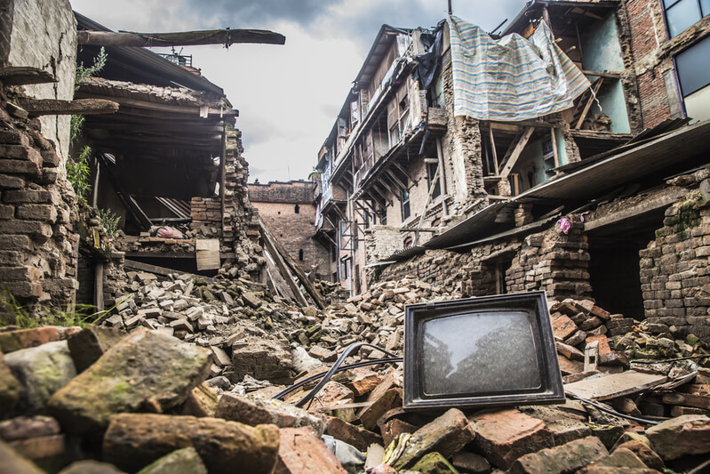
The actual value of an earthquake's intensity is given as a number on the Modified Mercalli Scale (MMS).
This scale is named after Giuseppe Mercalli, an Italian volcanologist. It displays numbers as Roman numerals.
The Modified Mercalli Scale goes from I (not even felt) to XII (total devastation). A number is assigned based on the damage reported and the level of shaking.

Slide 15
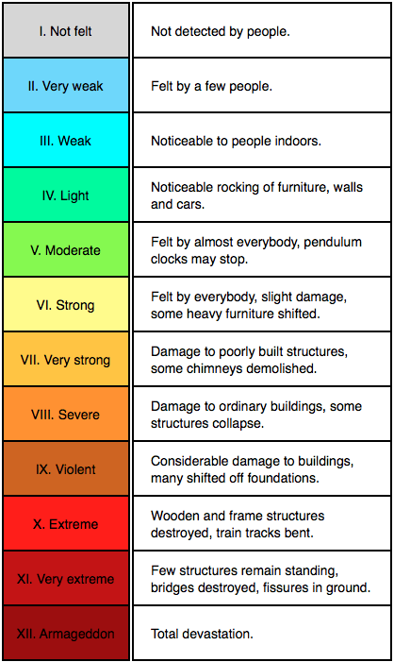
The Modified Mercalli Scale of Earthquake Intensity

